Slide 1

Fruit prices

Slide 2





TABLE OF CONTENTS
Information about the fruit prices database
01
02
What is the most expensive fruit?
03
Does the cup equivalent size affect the retail price?
04
05
Questions?
Does the form of fruit affect the retail price?

Slide 3

FRUIT PRICES DATABASE 2022
62 ROWS OF DATA
18 DIFFERENT FRUITS
5 FORMS OF FRUIT
Retailer

Slide 4

What is the most expensive fruit?

Slide 5

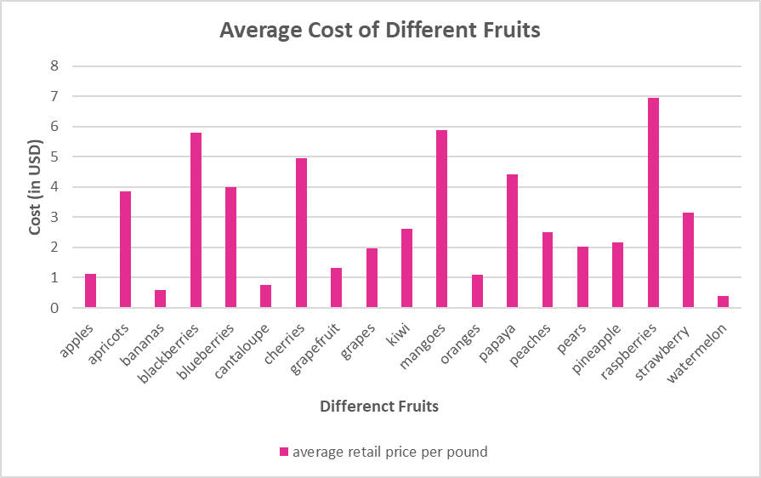

Slide 6
Does the cup equivalent size affect the retail price?

Slide 7
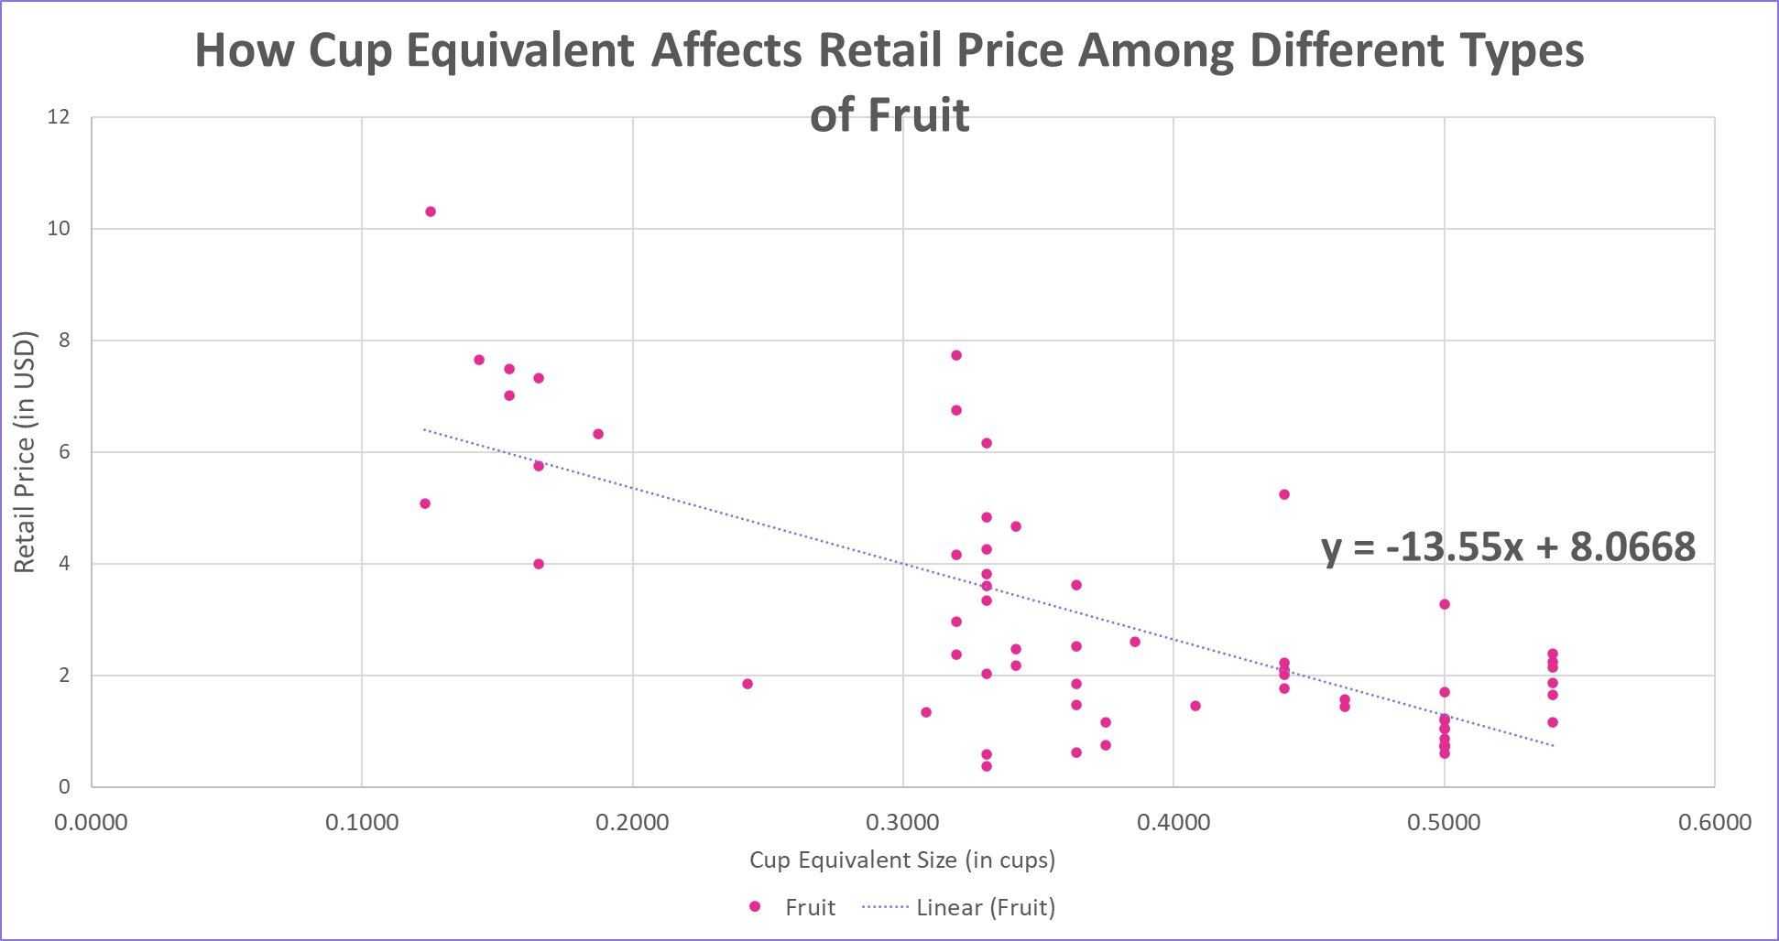


Slide 8
Does the form of the fruit (fresh, canned, frozen, and dried) affect the retail price?

Slide 9

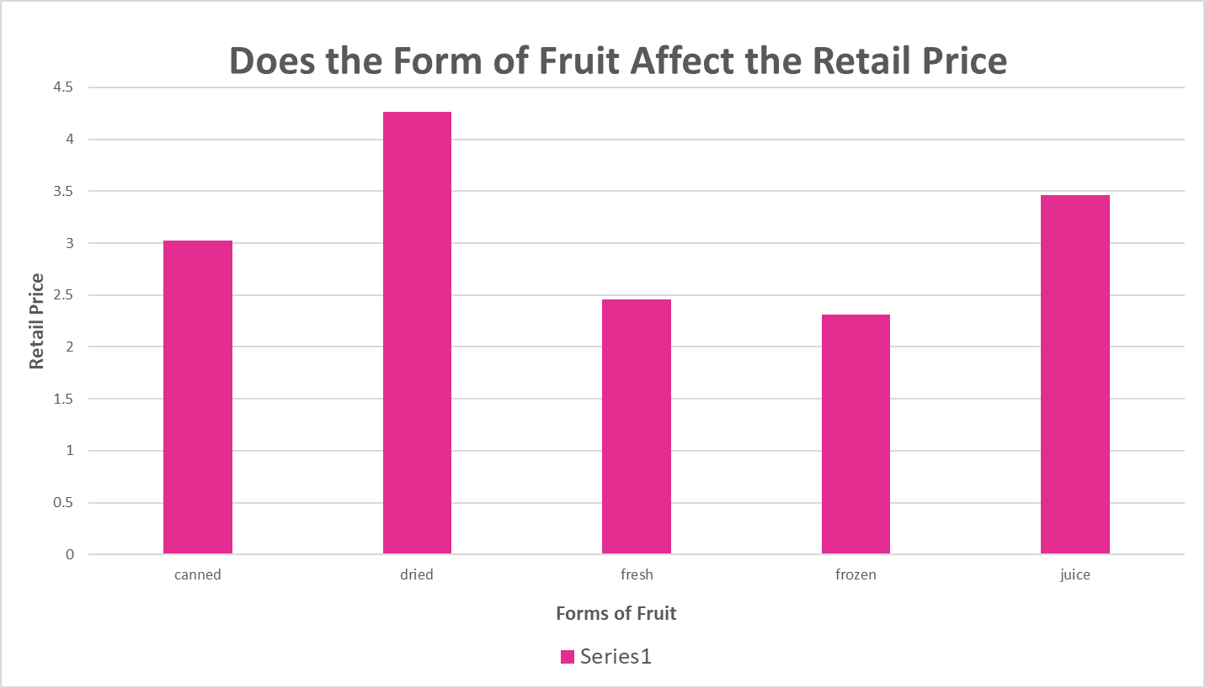

Slide 10
GOALS & STRATEGY
02
03
Questions?
BUDGET
05
Here you could describe the topic of the section
Here you could describe the topic of the section
Here you could describe the topic of the section

